Slide 1
2024 Final tax Levy & 2024 Budget
December 11, 2023

Slide 2
agenda
Budget Process
Final Tax Levy
Proposed 2024 Budget
Staff Recommendations
Questions/Comments

Slide 3
2024 budget process
April 22 Town Hall Meeting
May 8 Discuss Outlooks and Objectives with City Council
July 24 Discuss Proposed 2024–2028 Capital Investment Program (CIP) with City Council
September 11 Discuss Proposed 2024 Budget and Property Tax Levy with City Council
September 25 Adopt Proposed 2024 Budget and Property Tax Levy and Final HRA Levy
October 23 Discuss Proposed 2024 Utility Budgets/Rates and 2024-2028 CIP with City Council
November 13 Adopt 2024 Utility Rates / 2024 Budget Discussion with City Council
November 27 Conduct Truth-in-Taxation Public Hearing
December 11 Consideration of Adopting Final Levy, 2024 Budget and 2024-2028 CIP
Notes:
Our budget meetings and conversations really started with the Town Hall Meeting in April, with additional meetings and conversation in May, July, September, October and November. The City received no comments regarding the tax levy and budget at the Truth in Taxation Hearing. We did have one individual that had a question regarding valuation that attended the Truth in Taxation hearing and that was handled directly after and the following morning by City staff.
Not shown here are multiple rounds of departmental budget meetings with the City Manager. The process to date clearly shows how much work and discussion has gone into the budget process

Slide 4
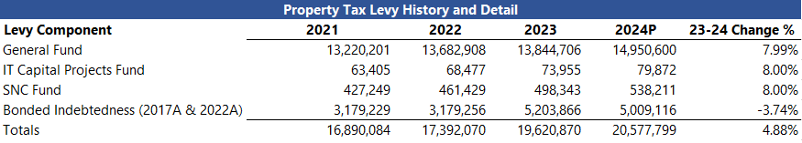
Final Tax levy
Final levy increase of 4.88%
$37 annual decrease to City property taxes for median value home

Slide 5
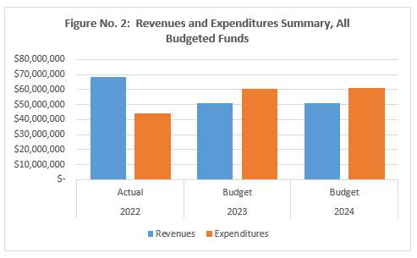
2024 budget – all funds
Notes:
The 2024 Budget authorizes $61,360,600 in expenditures supported by $51,185,000 of revenues. To support this planned variance, the City plans to make use of fund balance, including fund balance from the Parks Capital Projects Fund from bond proceeds received last year in 2022. For Actual 2022, you can see significantly more revenues (in blue) than expenditures (in orange). The 2024 General Fund Budget authorizes $22,639,700 in expenditures supported by $22,639,700 in revenues.

Slide 6
Property tax programs available
Regular Property Tax Refund
  Provides refund to those who meet certain income guidelines
  Must be homesteaded (owned/occupied as primary residence)
  https://www.revenue.state.mn.us/homeowners-homestead-credit-refund
Special Property Tax Refund
  Provides refund to those who’s property tax bill has increased by more than 12%
  Must be homesteaded (owned/occupied as primary residence)
  https://www.revenue.state.mn.us/homeowners-homestead-credit-refund
Senior Citizen Property Tax Deferral Program
  Allows you to defer a portion of property taxes owed
  Property tax bill you pay will be 3% of total household income (prior year income)
    Tax Bill increased maximum amount of household income allowable from $60,000 to $96,000
  Deferred portion plus interest must be repaid
  https://www.revenue.state.mn.us/property-tax-deferral-senior-citizens

Slide 7
Staff recommendations
Based on the process to date, staff recommend the following:
  Approval of Resolution No. 2023-146, Certifying the Final Tax Levy Requirements for 2024 to the County of Anoka
  Approval of Resolution No. 2023-147, Approving a Budget for the Fiscal Year 2024 and the 2024-2028 Capital Investment Program
Staff would then transmit them to Anoka County
Budget summary will be published in City Newsletter
2024 Budget and 2024-2028 Capital Investment Program on City’s Website under “City Financials”

Slide 8
Thank you! Questions?
2024 Final tax Levy & 2024 budget

